Slide 1
STAGES OF INTERNATIONAL BUSINESS
Dr. Srinibash Dash
Associate Professor & Head
School of Management
GMU,SBP

Slide 2
WHAT IS INTERNATIONAL BUSINESS ?
It is the process of focusing on the globe and objective of the organization on global business opportunities and trades in order to produce sales , buyer exchange of goods and services world wide.

Slide 3
Stages of internationalisation
There are five stages of internationalisation.
Those are :-a)Domestic Company
b)International Company
c)Multinational Company
d)Global Company
e)Transnational Company

Slide 4
Stage-1(Domestic Companies)
These type of companies:
Limits its operation ,mission ,vision to national political boundaries.
Focus on domestic- market opportunity, supplier ,fiancial companies ,customers.
Analyze national environment of the country and formulate the strategy to exploit the opportunities offer by the environment.

Slide 5
Stage-2(International Company)
This company export the product manufacture in the home countries.
Some of the domestic company to extend its operation beyond domestic market capacity . Those companies to decide to exploid the the oppertunities outside of the domestic company at this stage.
International company focus on domestic practices but,extend wings to foreign countries.This companies remain ethnocentric/domestic country oriented and the domestic company view foreign market as an extension to domestic market.

Slide 6
Stage-3(Multinational Compny)
MNC’s establishes its branches, sub-branches in various countries and operation like a domestic company in each foreign company sooner or later international company learn that the extension strategy will not work.
It formulate different strategy for different market.
EXAMPLE:-
Toyota export toy pet car’s produced in Japan to USA.It was not success due to over size and under power.
Than Toyota design new models of cars,suitable for USA market.They turn to MNC’s when they have specific needs regarding different country market price,production promotion and marketing.
It is also known as multidomestic companies.It adopt diffrtent strategy in different country.

Slide 7
Stage-4(Global Company)
This company produces globaly an markets localy and produces localy and market globaly.
Example:-
Dr.Reddy’s name lab design and produces products India and market it globaly.
Globaly company produces in home companies and focus on marketing the products globaly.It also focus on marketing the product domesticaly.

Slide 8
Stage-5(Transnational Company)
This companies produces, markets, invest, operates across the world.It is an integrated global enterprise that links global resource with global market at profit.
Example:
Pepsi, Cocacola

Slide 9
CONCLUSION
  From the above data we get that ,in international business all these stages are required .
  All the stages give the idea of all type of compaies.
  By the help of the domestic company we can know about the different type of company.By compliting the 1st stage we can proceed further.

Slide 10
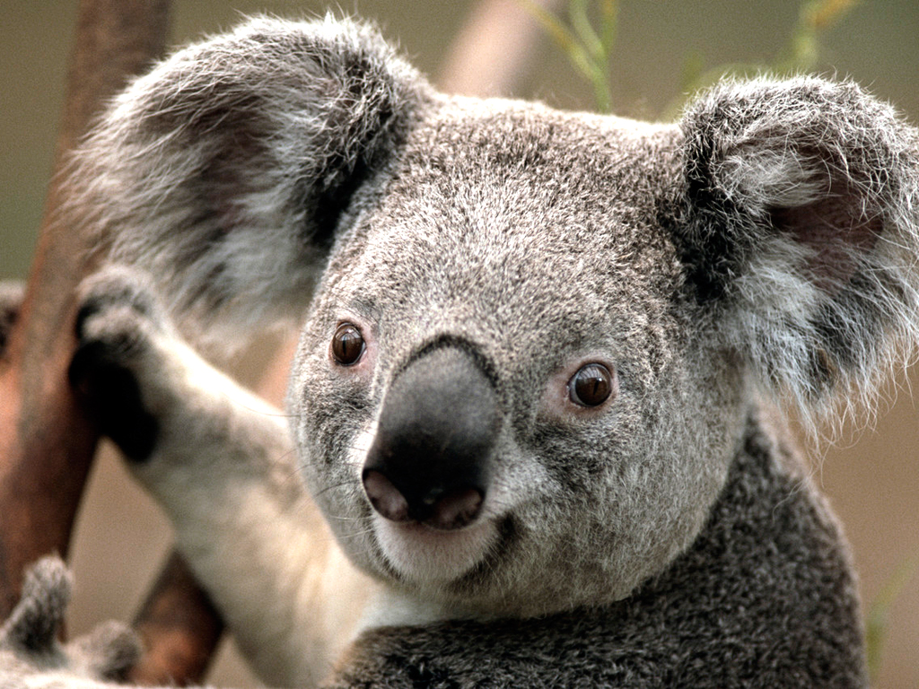
THANK YOU

